Slide 1
The End of Jobs
Money, Meaning and Freedom Without the 9 - 5
Taylor Pearson

Slide 2
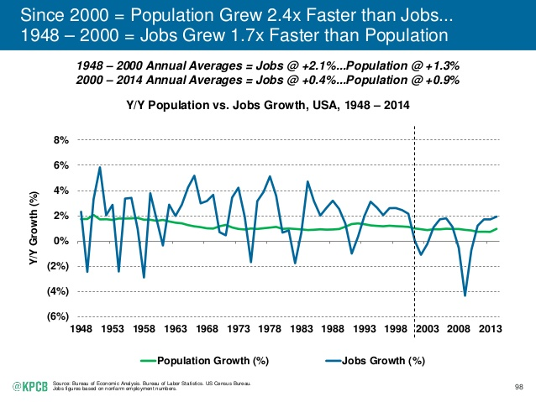
Notes:
This is what’s going on
Report from Kleiner PerkinsCaufield and Byers Internet trends of 2015
For the 21st century, jobs have been in decline relative to population growth
The popular explanation for this is that we’re growing through a global economic recession and if you just hold on, we’ll bounce back.
Just trust that the powers that be, banks, governments and corporations are going to turn the situations around.
Well, that didn’t really square with my experience or the experience of a lot of people I’ve talked with
Let’s take a trip, first stop, the bastion of 21st century capitalism - Vietnam

Slide 3

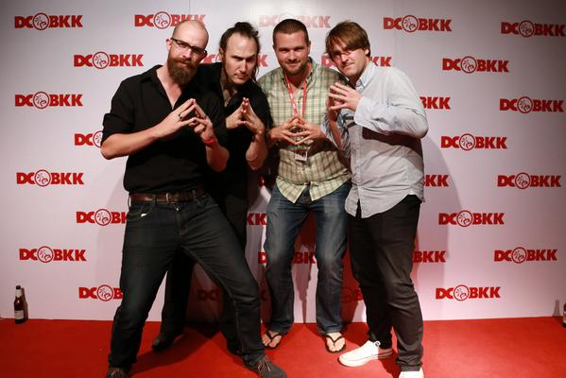

Slide 4
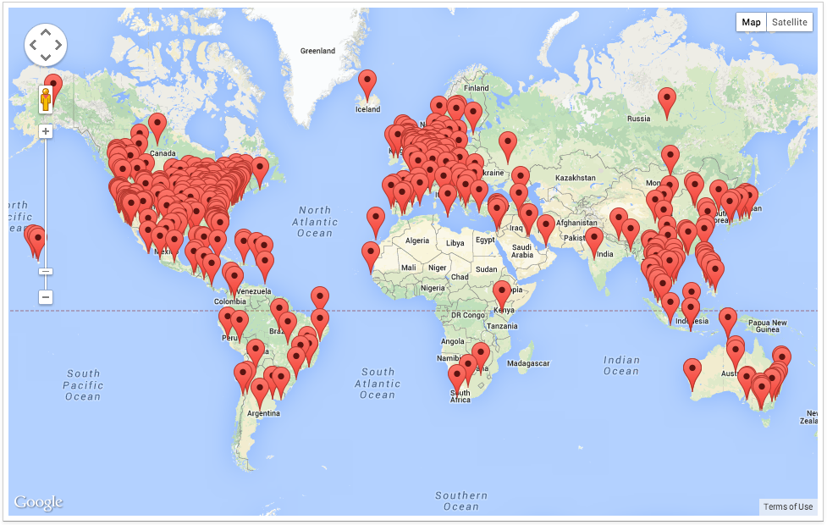
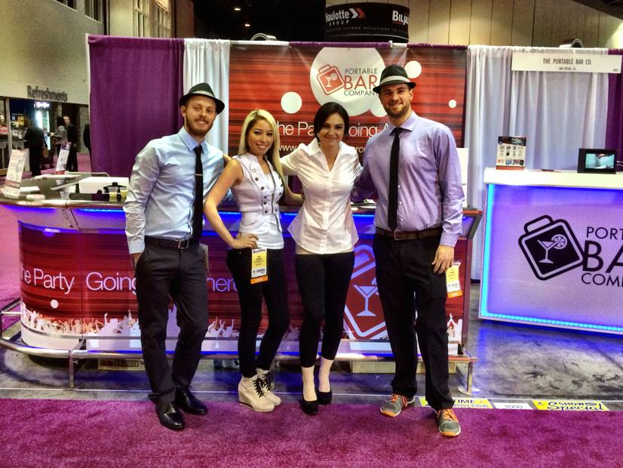
Notes:
How did I end up going from college and what was different about that world and the world I live in now.
It’s not geographic – photo of entrepreneurs all around the world
I went to work with two entrepreneurs who owned a publishing business that provided a forum/events for entrepreneurs around the world and a physical product business
I managed that business with the guy in that picture, I ran the front end marketing and he managed the backend and we split time on sales, this is us at a trade show in orlando
During a two year period when my friends in Birmingham couldn’t do the medical specialty they wanted, got bad raises, and were bouncing around looking for a job they like, I travelled the world and grew the that particularl company 527% and the overall portfolio by aroun 50% yoy. That’s 50% yoy vs. 3%, not a trivial difference.
What’s going on? That was the question we were discussing the morning after that picture at the conference was taken.

Slide 5
Jobs are getting more competitive and less profitable while entrepreneurship is more accessible, safer and profitable than ever.

Slide 6
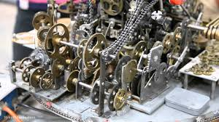

Slide 7
Have We Reached the End of Jobs?

Slide 8
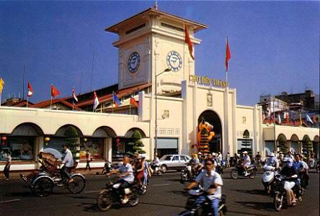

Notes:
I’m not being facetious, Vietnam may say it’s communistic but everything about the day to day experience in the country is reminiscent of an almost sort of Ayn Rand level of pure capitalism.
Maybe it’s not a stretch to imagine this in street vendors.
That same culture though has carried over into the 21st century and the computer image is a much more honest representation of Vientam and much of SE Asia, Eastern Europe and South America today
What’s happened is that Large multinational companies and international came in 20 or 30 years ago and funded education and that hustle went from selling lychee fruit to selling services as a computer programmer.
In parallel communication technology has gone from paying $5 a minute for a phone card over a terrible connection to Skype – free, approaching ubiquitous communication around the world
The point being that Now guys like Jesse can come and set up a dev shop in less than 6 months where they have access to talent that’s equivalent to the U.S. for a fraction of the price.
Effectively anyone in the knowledge economy with a job that doesn’t rely on physical presence – book keepers, accountants, are competing with a very hungry, very motivated gobal workforce living in places with much lower costs of living
College graduate numers

Slide 9
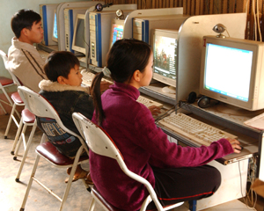

Slide 10
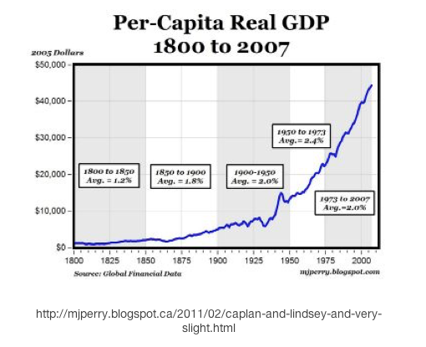
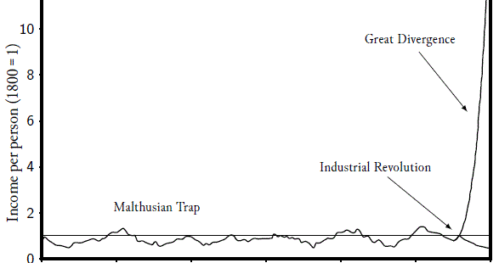
Notes:
At the same time as other people around the world are rising up to compete with the Middle Class, we’re also seeing the Acceleration of Technology
Software is eating the world – A16Z
Over two billion people used broadband internet in 2014, up from around 50 million a decade earlier in 2004.
Jobs are replaced by software
Block buster (60k jobs) → Netflix (2k jobs)
Kodak → Flickr, Shutterfly
This is driven by Moore’s Law – Since 1965, computer power has roughly doubled and cost has roughly halved every 18-24 months
We are linear creatures living in an exponential world
In 1980, AT& T hired McKinsey & Co— one of the most prestigious management consulting firms in the world— to predict how many cell phone users there would be in the U.S. in 2000. Based on the large study they conducted, they predicted there would be around 900,000. There were actually about 100 million. So close! Only off by ninety nine million one hundred thousand— a factor of 120
When the human genome project began in 1990, it took seven years of costly labor and employing the smartest scientists in the field to sequence the first 1% of the human genome. Many critics fought to cancel the project, arguing it would take too long and was too expensive. But instead of taking another seven years to sequence the next 1%, it took a single year. In the next year they doubled again, from 2% to 4%. The trend continued and the project was completed in fifteen years. A project that took seven years to reach one percent completion, was finished in 15 years total. 99% of the project was done in about half that time.
Again, these were some of the best educated people on Earth – world class scientists and a highly respected consulting firm. Have you adjusted your mental model to incoporate this.

Slide 11
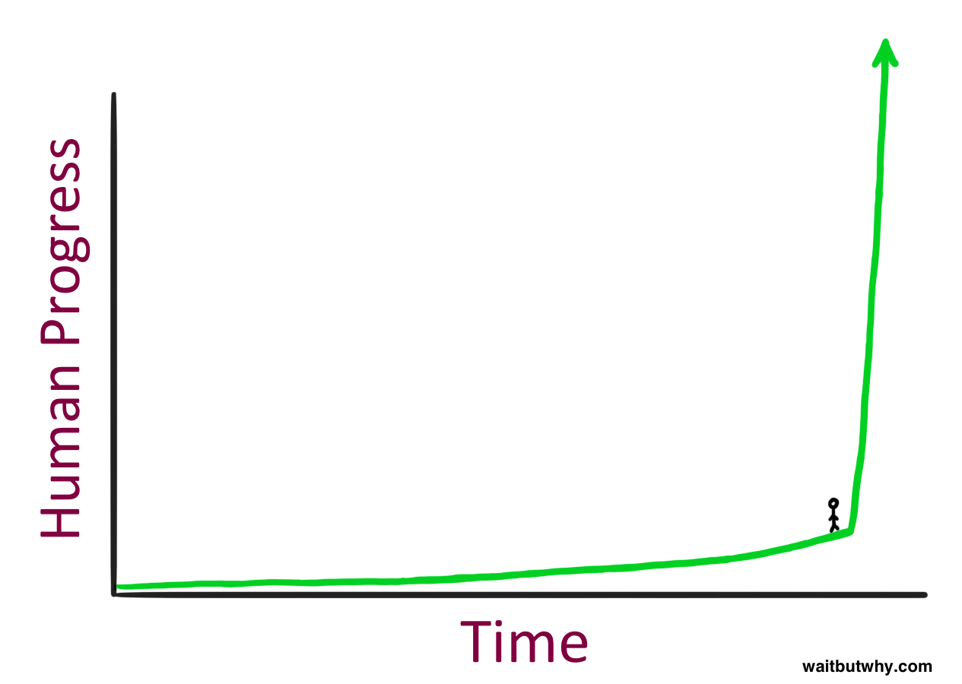

Slide 12
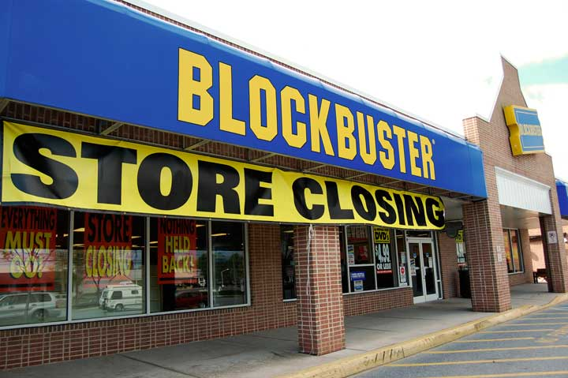


Slide 13
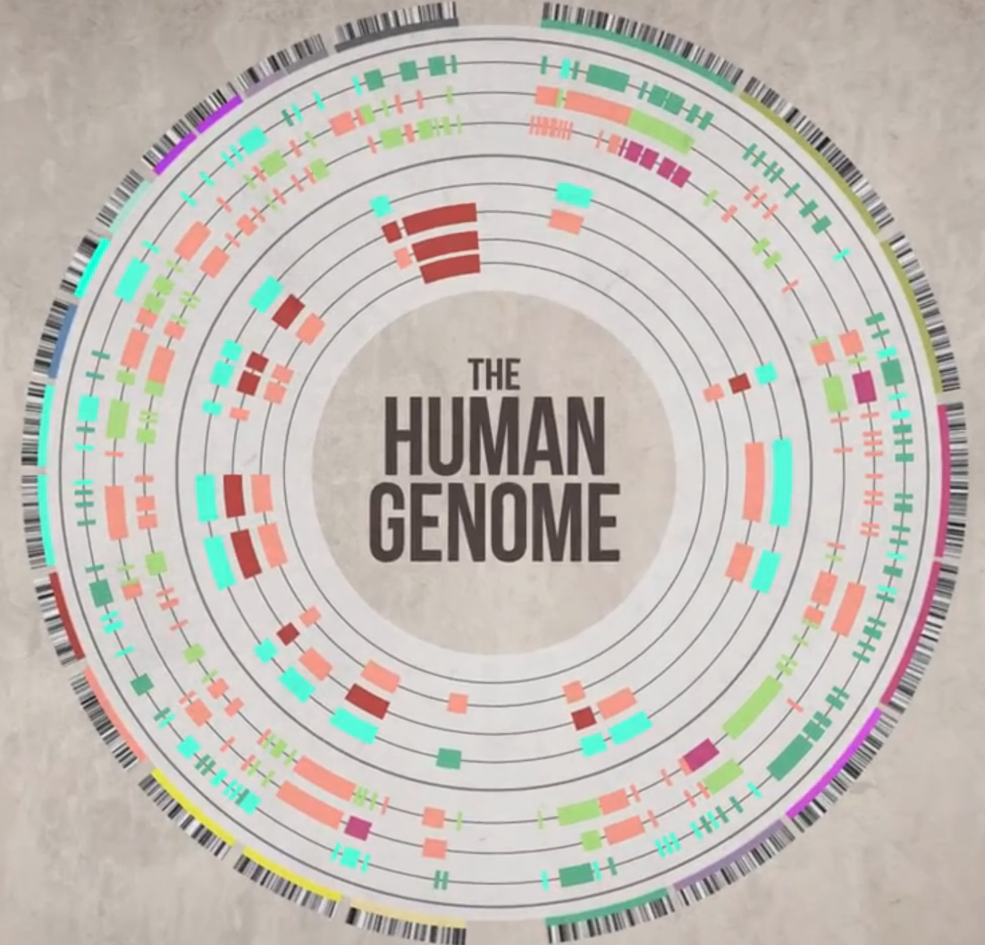
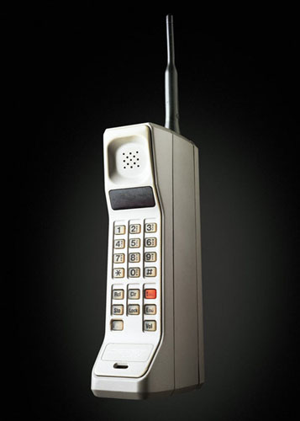

Slide 14


Slide 15
Why are we at the end of jobs?

Slide 16
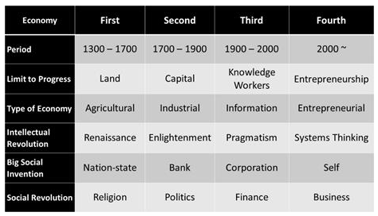
Notes:
The Entrepreneurial Economy (2000ish-???)
I said earlier that the popular conception of what is going on is that we’re in an economic recession
What I argue is that we are actually transitioning between two distince economic periods
Work has moved from simple → complicated → complex over the past 800 years
Moreover, the people that have been the first to make that transition have been the ones who benefitted the most
IBM and knowledge
We are roughly at the point the entrepreneurial economy that people were in the knowledge eocnomy in the early 20th century
It’s more difficult to enter it than it will be in 10 or 20 years, but the rewards are probably as high as they’ll ever be.

Slide 17
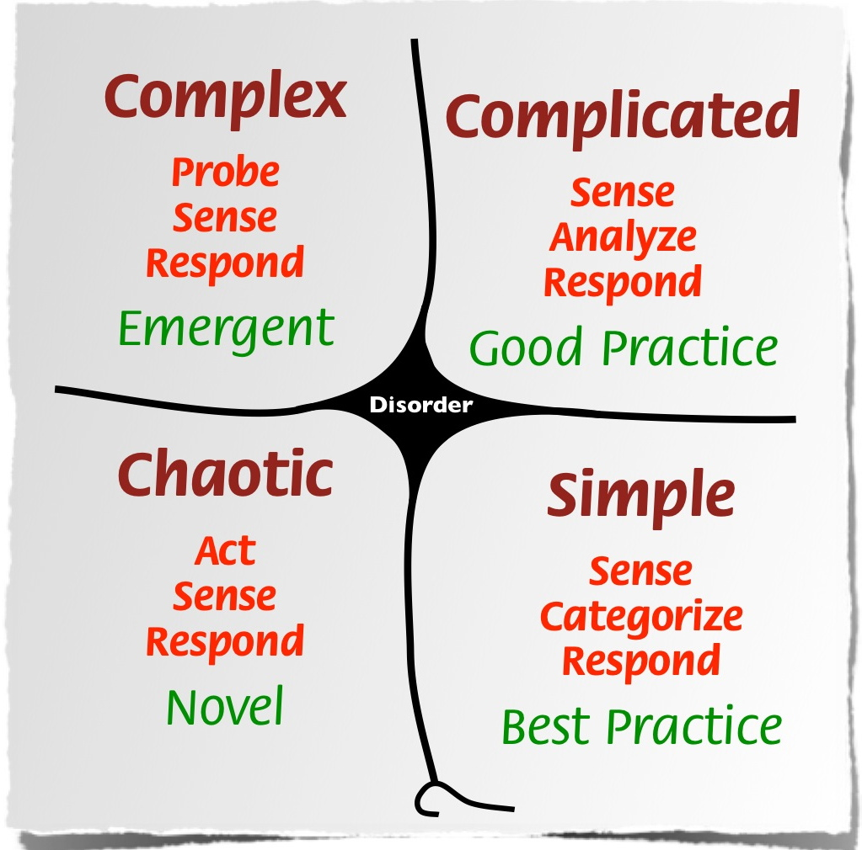
Notes:
The Commoditization of Credentialism
Story in NY Times about Landon and Megan, a runner and clerk at a law office respectively who were earning 35-45k/year with 6 figures in student in debt
The law firm simply required everyone to have a degree because “it’s a buyers market for employers” – they needed some way to filter
Most everyone will agree with two statements – 1. Degrees are getting more expensive, there’s lots of data for this and 2. that they are getting less valuable. While a degree used to guarantee a good job, it doesn’t anymore.
The way a lot of people have tried to manage this is to get get more degrees, pushing harder on the shorter lever.
Instead, it’s better to pick a longer lever. In this case, a longer lever is moving from simple and complicated to complex work which is the transition we’ve been on for the last few hundred years

Slide 18
Is Entrepreneurship Safer than Ever?

Slide 19
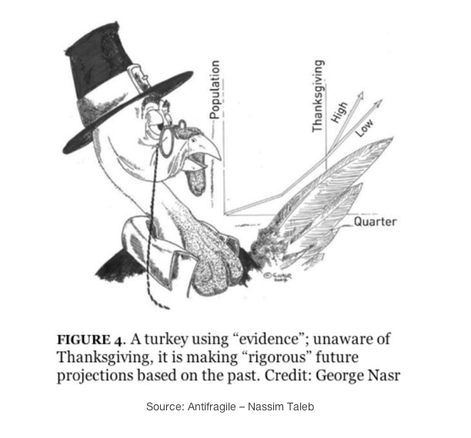
Notes:
Traditional universiti
The day on which the turkey believes with the highest degree of statistical confidence that things will continue to get better is the day before Thanksigving
It has been fed for 1000 days by the Butcher before.
Max vs. Rand example
The way you would typically talk about an accountant leaving their job is leaving something safe to pursue something risky.
This is not true.
If you are a mid career guy and get the axe, that is way worse than getting axed sooner.

Slide 20
The Long Tail (or Why Entrepreneurship is More Accessible than Ever)

Slide 21
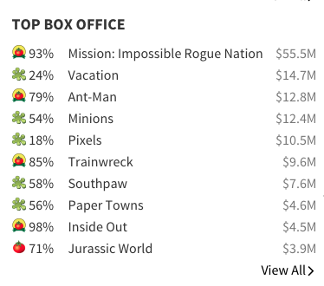
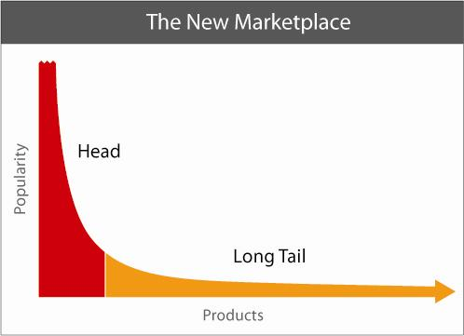
Notes:
The Long Tail Means Entrepreneurship is More Accessible
The Long Tail by Chris Anderson recounts the story of Birdmonster
Traditionally, bands hadto go through record labels to get financicing to rent a studio, distribution channels, and marketing/branding
Birdmonster recorded in a local independent music studio and used cheap software like garage band to record the music so no need to financing
They uploaded their music to CD baby and other online stores where it could be distributed.
They were able to read and study online everything they needed to know about marketing and probably do it better than traditional studios
These exat same forces are coming to business

Slide 22
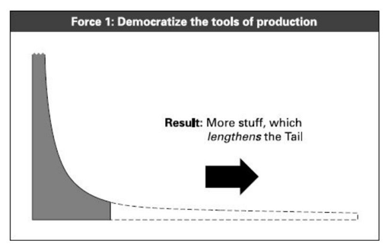
Notes:
If you were trying to start a physical product company 20 years ago….
You had to go to China
You had to deal with a ton of middlemen
China was not doing short run manufacturing 20 years ago.
Now you can source over Alibaba and do short run manufacturing or even dropship from an existing manufacturing company.

Slide 23
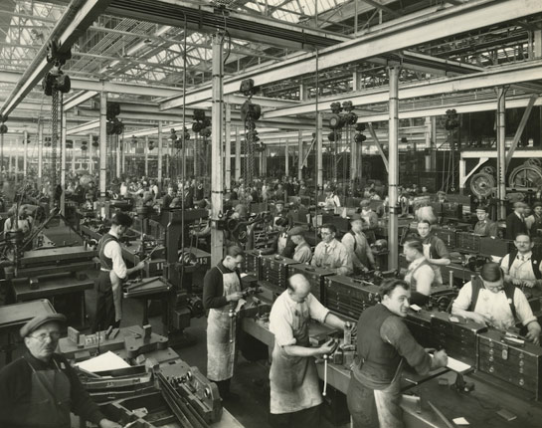

Slide 24
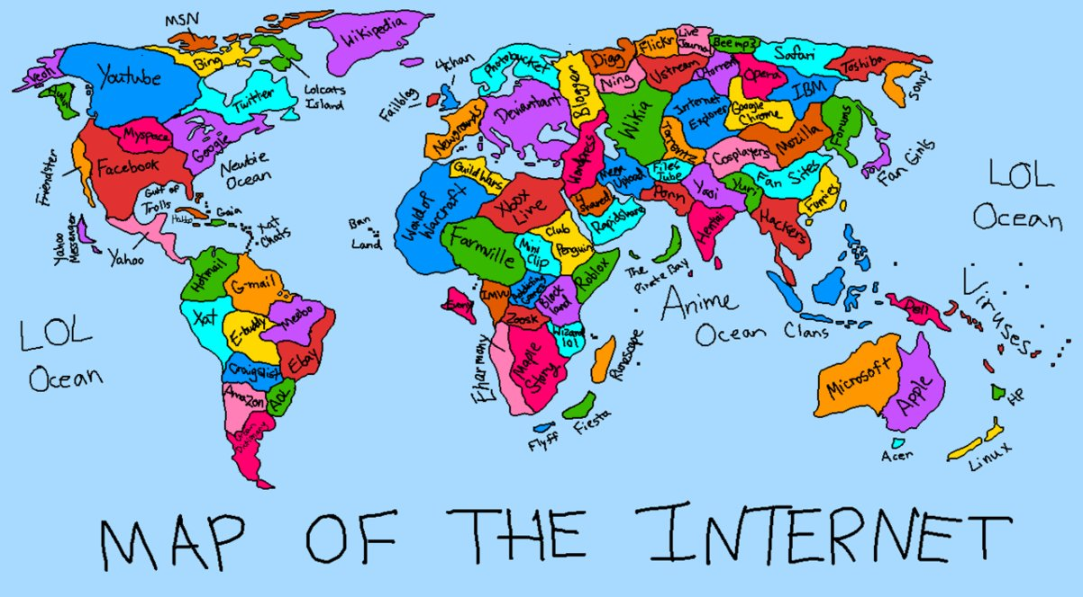
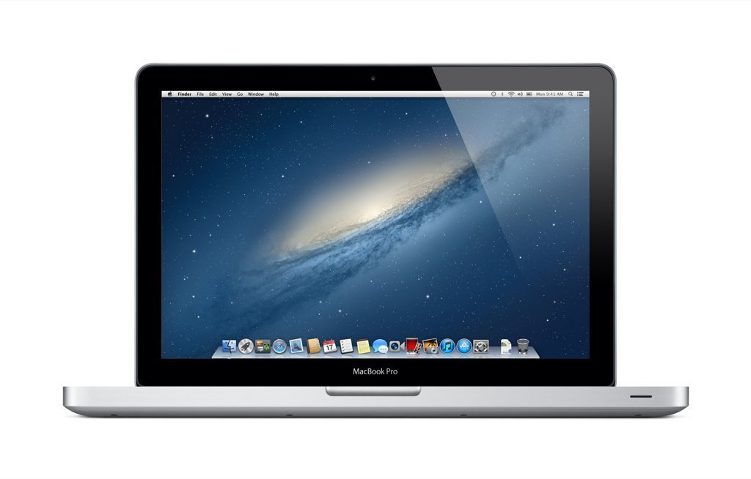

Slide 25
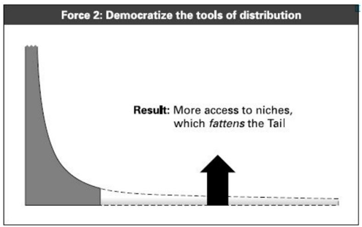
Notes:
Then you had to get a storefront on Main st. and sign a two year lease for 10s of thousands
Not anymore, now you set up a shopify site for $14
You blog, you podcast, you start a Youtube channel, not pay for a billboard or ad in the yellow pages. Getting into those distribution channels is much less expensive.

Slide 26
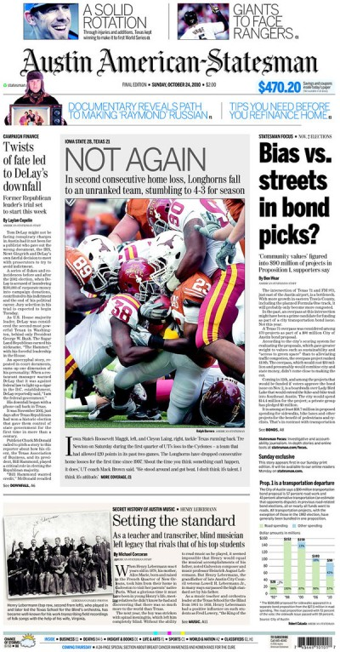
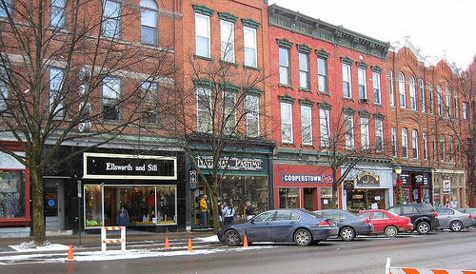

Slide 27

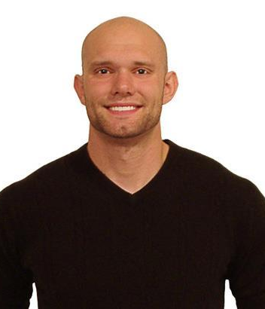

Slide 28
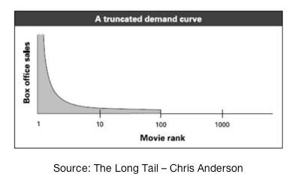
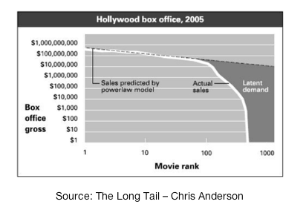
Notes:
There’s also new markets
Firegang Dental → for dentists not for people from Cincinati

Slide 29


Slide 30
Is entrepreneurship more profitable than ever?

Slide 31
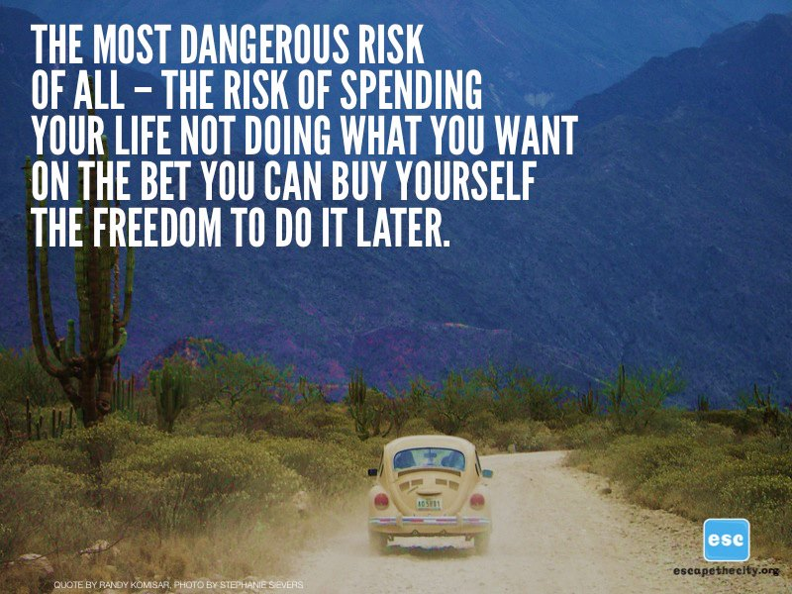
Notes:
We see people who are dumping their corporate salaries for entry level positions at companies which allow remote work
Given a clear cut choice between money and freedom, they are taking freedom and autonomy
This is a natural human drive

Slide 32
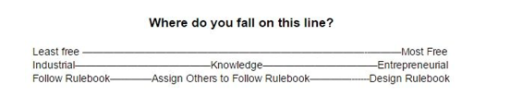
Notes:
Most people don’t realize this however and as a result don’t take advantage of it.
Most people are stuck in the mindset of choice over design when the opportunity today is to design
The least free people are those that watch Jeopardy, are told to “stay tuned and do so”
The middle class has a much greater level of freedom, They are more likely to structure their families and hobbies in ways they find more meaningful and not just as the mass media may instruct them. At work they are likely to do things which require solving more complex problems and defining tasks for others.
But the most powerful are those who design both their own realities and the realities of others. They write the TV shows and design the products that the masses consume. The entrepreneur defines reality, he is not defined by it. He is engaged in a dialogue with his reality asking “why” and “why not” instead of “how” or “what.”Pearson, Taylor (2015-06-28). The End of Jobs: Money, Meaning and Freedom Without the 9-to-5 (Kindle Locations 1973-1975). . Kindle Edition.

Slide 33
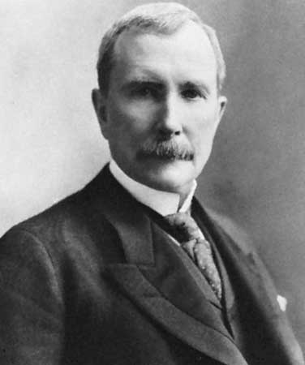
Notes:
What most people don’t realize is the level of freedom that is available today should they choose to seize it.
Broad swaths of the American middle class now have more freedom and access than the richest man on Earth did 100 years ago.
I realized at one point writing the book and having a conversation with the guy in the apartment next to me that he was actually free than John D Rockefeller.
He was taking a two week trip to Europe
Rockefeller left the country once – boat is an affair, plane trip is an afternoon
The informational advantages Rockefeller used to grow Standard Oil in it’s heyday could be overcome by an iPhone with a free stocks app

Slide 34
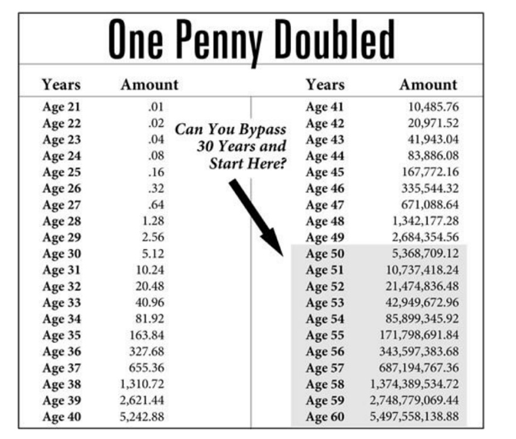

Slide 35
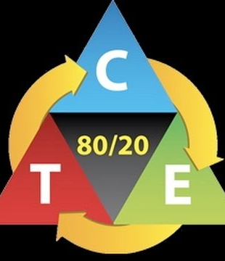

Slide 36
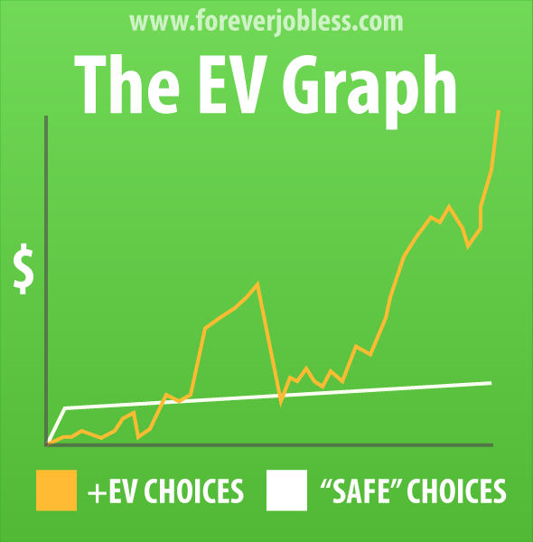
happierhuman.com

Slide 37
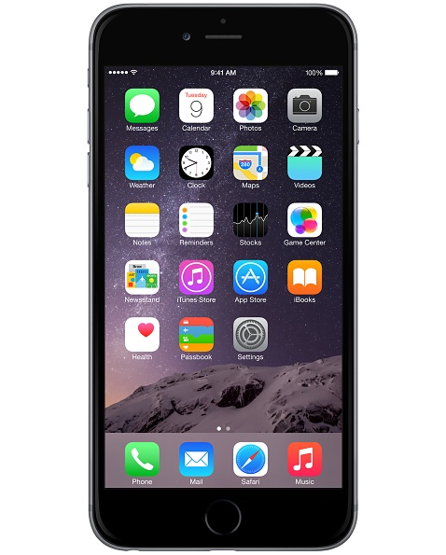
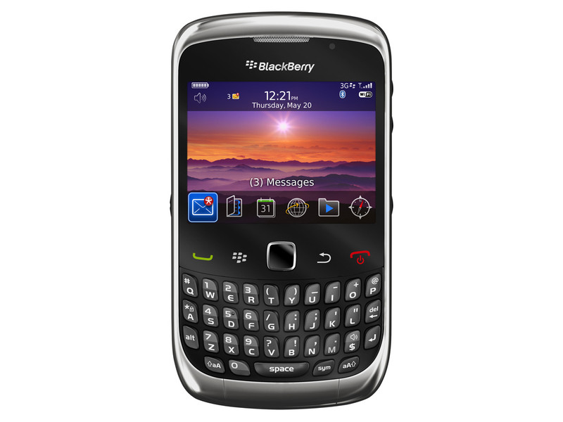
Notes:
What’s more is that choosing to exercise that greater degree of freedom is not just rewarding in and of itself, but is financially more rewarding
Edward Deci, the founder of Self-determination theory, noticed in his experiments and observations that great work emerged when individuals had more freedom, and were, in a sense, allowed to be more entrepreneurial.
If we look at the individuals who have made great contribution to society, they did so by their own choice – Van Gogh, Da Vinci, Galileo were not conscripted into their work
Imagine someone telling Steve Jobs that he had to design a new phone. Given that sense of obligation, he likely would have just made a slightly better Blackberry. Great work— the kind of work that will create wealth in our lives and the lives of others is not the product of obligation— is the product of freedom. Freedom gives us a longer lever, a better leverage point.

Slide 38
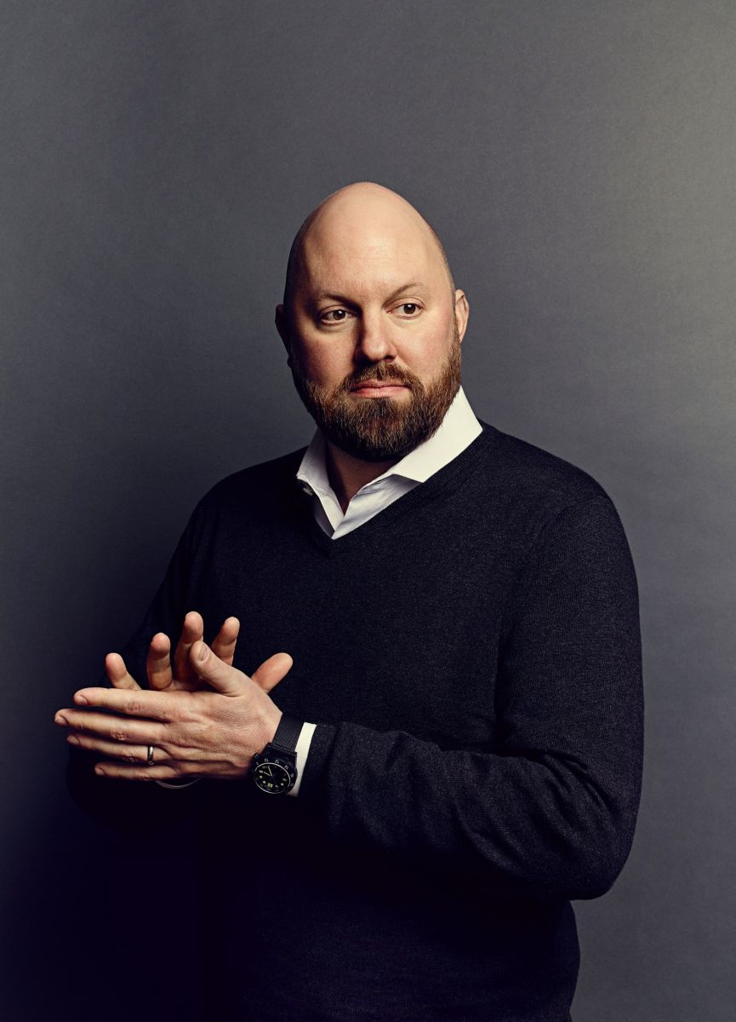
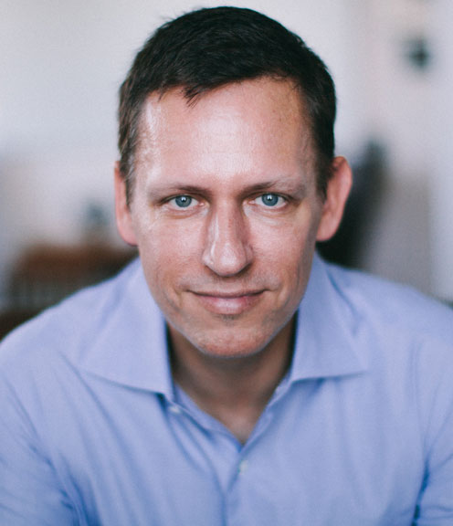
Notes:
These guys have done a LOT of pattern matching around what makes successful entrepreneurs and have a very large incentive to understand what it is.
One conclusion they both seem to have reached independently is that being obsessed with the problem is meaningful
Andreesen and yes-man meetings
Thiel and Facebook offer from Google
Meaningful work is not only more personally rewarding, it’s more profitable.

Slide 39
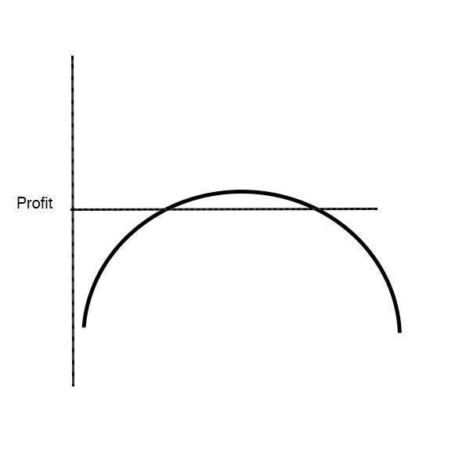
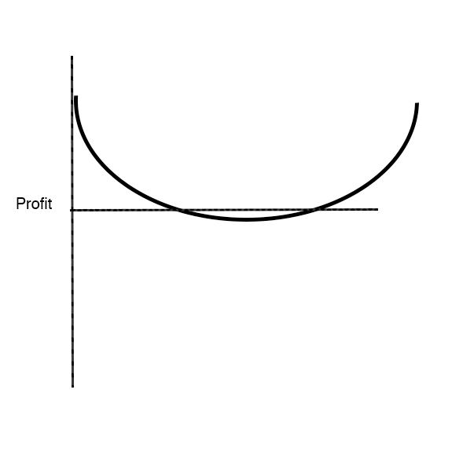
Career Risk

Slide 40
What are the paths into Entrepreneurship?

Slide 41
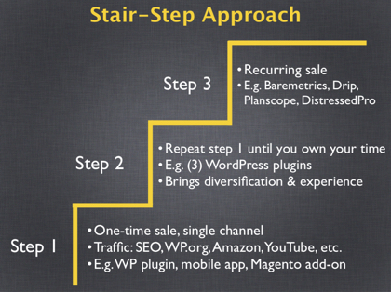
softwarebyrob.com

Slide 42
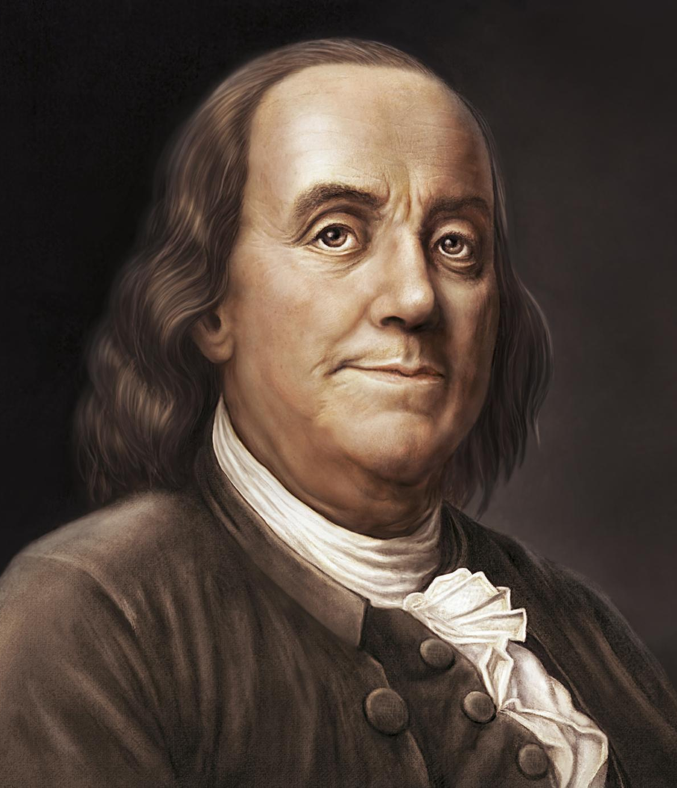
Notes:
Relationships
Learn to operate in a complex environment
Learn at scale/altitude
For employer
Less Risk
Attract more ambitious applicants

Slide 43
The End of Jobs
Money, Meaning and Freedom Without the 9 - 5
Taylor Pearson

